Slide 1
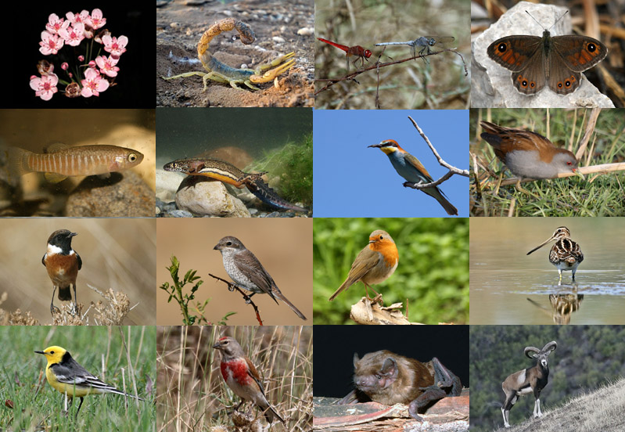
Species richness: Processes

Slide 2
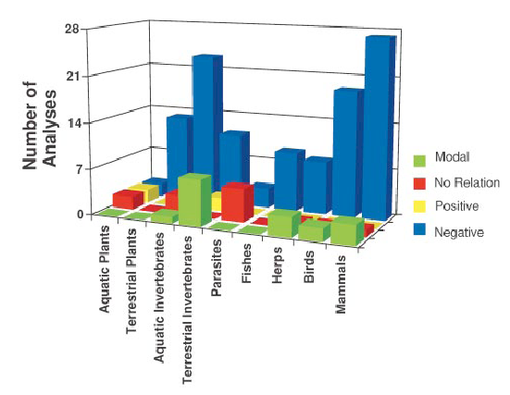
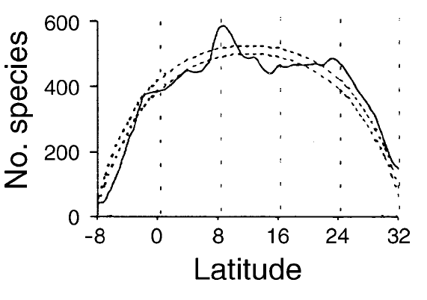
Where is biodiversity: THE PATTERNS
If we assume everything is correct, it seems that in general species are found on the tropics more so than in other places
Fishes
Mora & Robertson (Ecology 2005)
Willig et al (Annu. Rev. Ecol. Syst. 2003)

Slide 3
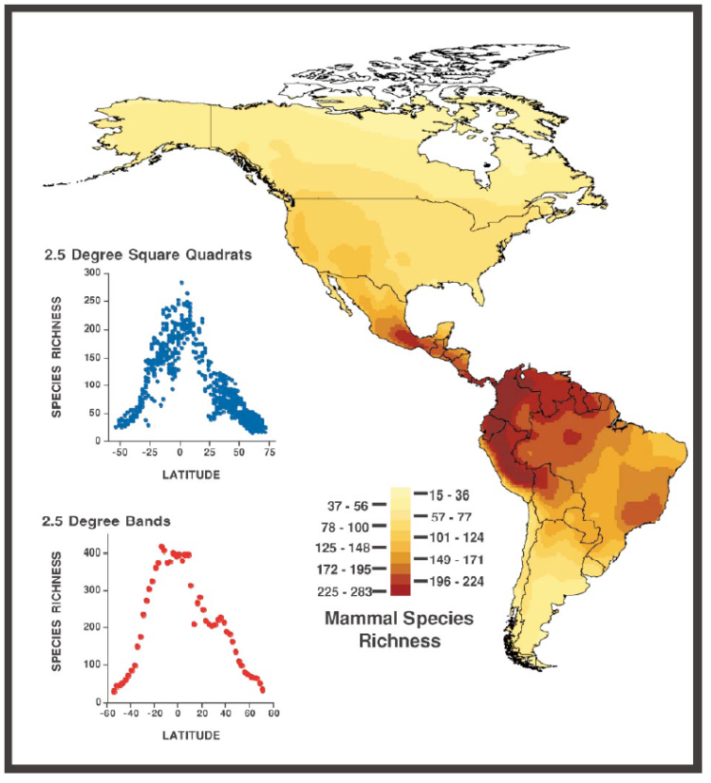
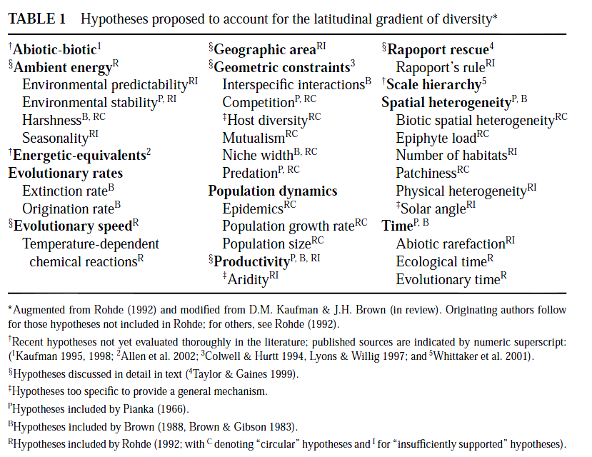
Why species are where they are?: THE PROCESS…NO ONE ANSWER
Willig et al (Annu. Rev. Ecol. Syst. 2003)

Slide 4
Why species are where they are?: the problem of having so many hypotheses
Multicollinearity
Response variable
Predictor 1
Predictor 1
Predictor 2
Predictor 2
Graham (2003): multicollinearity can lead to:
⇒ Spurious correlations (Type I errors)
⇒ Reduce statistical power of true relationships
⇒ Remove causal but weakly related predictors (Type II errors)
Notes:
12 minutes

Slide 5
The problem of collinearity in hypothesis testing:
Variation explained
Environment:
Phisiography:
Biogenic:
Anthropogenic:
Consequence of other patterns:
Null models:
Temperature
Salinity
Variability
Productivity
Number of islands
Coast length
Area of coral reefs
Coastal development
Fishing
Rapoport effect
Mid-domain effect
81
16
21
14
4
6
15?
25
23
64
90
359%
Mora & Robertson, Ecology 2005

Slide 6
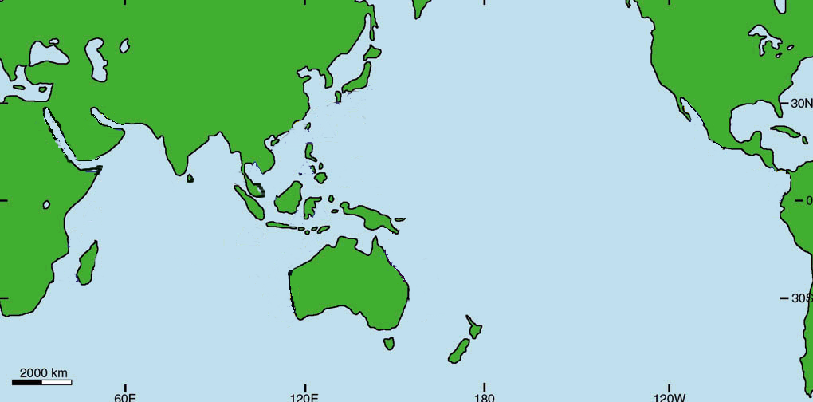
Why are there more species in the tropics?: THE MECHANISMS ARE NOT CLEAR
Center of Origination
IPR

Slide 7
Why are there more species in the tropics?: THE MECHANISMS ARE NOT CLEAR
Center of Overlap

Slide 8
Why are there more species in the tropics?: THE MECHANISMS ARE NOT CLEAR
Center of Accumulation

Slide 9
Why species are where they are?: Even within a specific hypothesis there is not a clear mechanism
A CASE STUDY WITH THE NUMBER OF PEOPLE HYPOTHESIS
?
Biodiversity
Human population

Slide 10
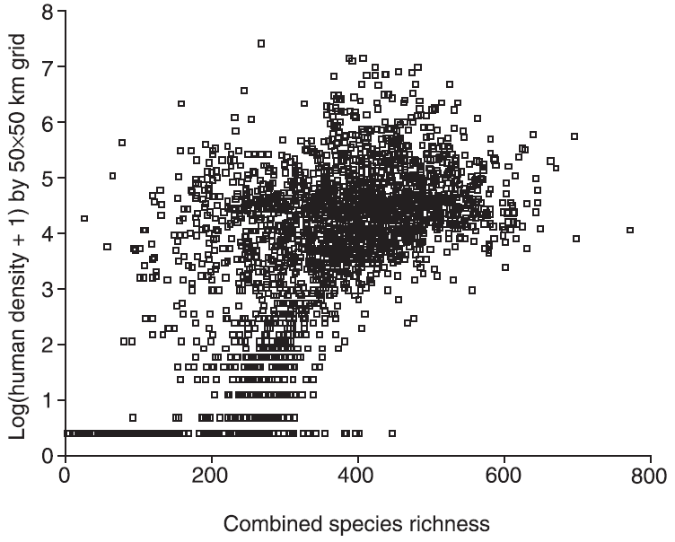
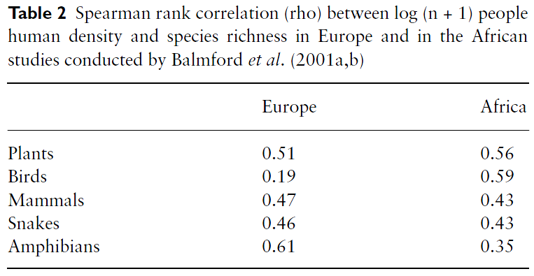
Why species are where they are?: THE MECHANISMS ARE NOT CLEAR…PEOPLE
…so why is that there are more species where there are more humans?...
Hypotheses:
1) Human population and species richness both respond similarly to the underlying driver of energy availability (Gaston, Progress in Physical Geography 2005)
2) Human land transformation near settlements increases species richness. The net gain in species richness whereby the number of new species introduced to an area is greater than the number lost (McKinney, Global Ecology and Biogeography 2002)
3) Climate stability hypothesis. Glacier refuges allowed humans and species to persist in the same areas (e.g. Fjeldså & Rahbek, Conservation in a changing world 1998).
4) Disturbance hypothesis. Humans act as disturbances allowing the filtering of more tolerant species, while minimizing the role of dominance of few species (Araujo Global Ecology & Biogeography 2003)
Araujo (Global Ecology & Biogeography 2003)

Slide 11
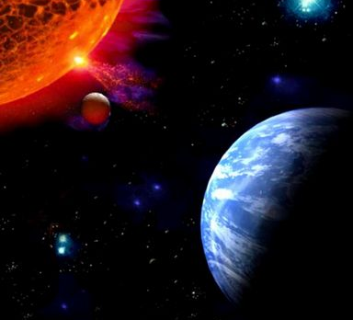
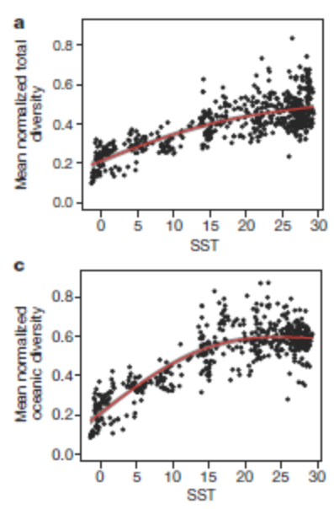
Why species are where they are?: THE MECHANISMS ARE NOT CLEAR
A CASE STUDY WITH THE TEMPERATURE HYPOTHESIS
Tittensor et al, Nature 2011

Slide 12
Why species are where they are?: THE MECHANISMS ARE NOT CLEAR…TEMPERATURE
“more individuals hypothesis”
more energy more individuals more species
“physiological tolerance hypothesis”
Temperature–richness relationships
More species survive under warm than cold conditions
“speciation rate hypothesis”
faster evolutionary rates or stronger biotic interactions increase the opportunity for evolutionary diversification in hot regions
Currie et al (Ecol. Let. 2004)

Slide 13
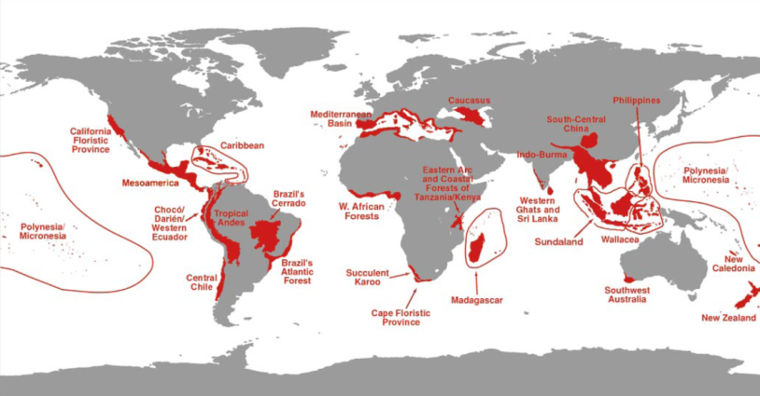
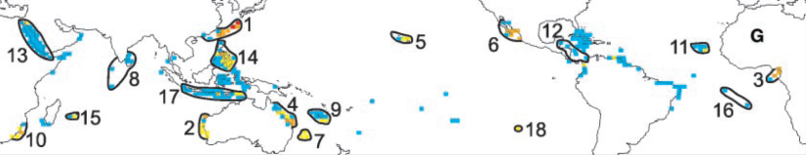
WHY IS SPECIES RICHNESS IMPORTANT: CONSERVATION
Key for delineating hotspots of biodiversity and allocation of conservation resources
About 10.000 species of vertebrates
About 1.000 species of animals
Roberts et al, Science 2002
Myers et al, Nature 2000

Slide 14
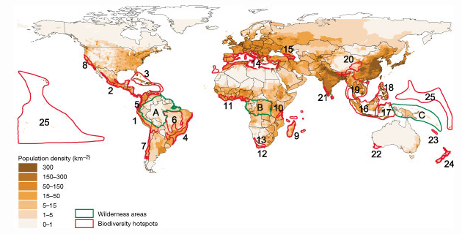
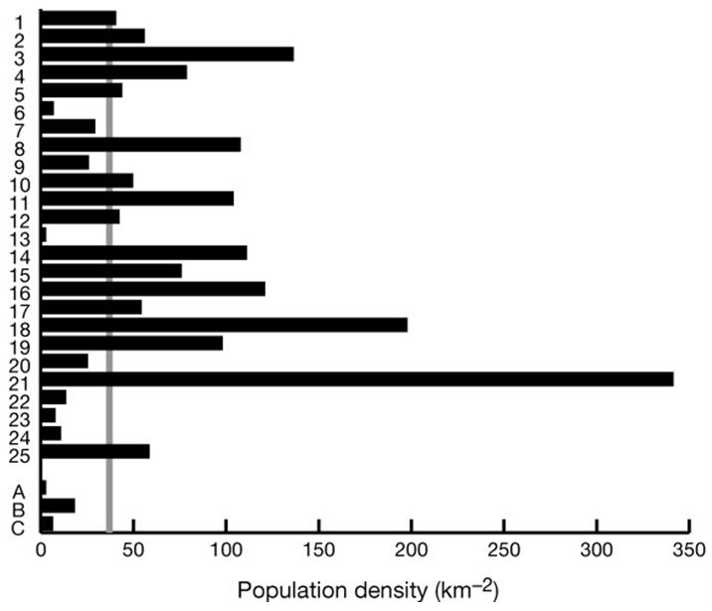
SPECIES RICHNESS AND CONSERVATION
Key for accessing biodiversity threats
Global average
Hotspot average
In 1995, more than 1.1 billion people, nearly 20% of world population, were living within identified biodiversity hotspots, an area covering about 1.4% of Earth's terrestrial surface (Cincotta et al Nature 2000)
42
73

Slide 15
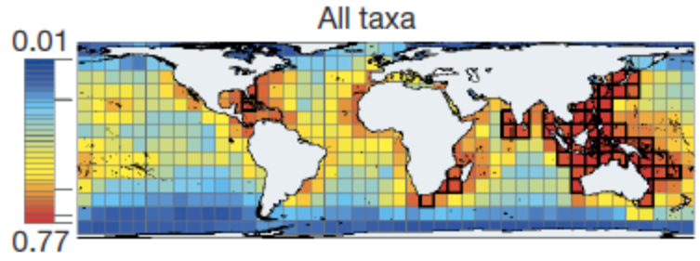
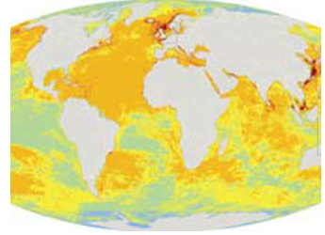
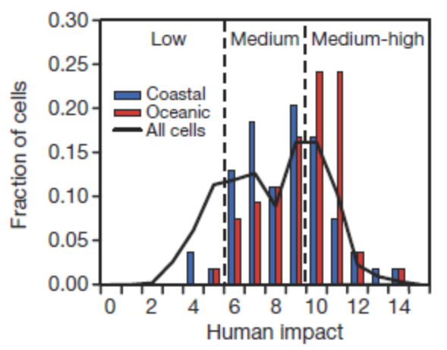
SPECIES RICHNESS AND CONSERVATION
Key for accessing biodiversity threats
Human footprint
Tittensor et al, Nature 2010)

Slide 16
In summary
1.5 million described
We are not certain how many species are there in total; but
8.7 million best estimation
Data standardization
Overestimation of patterns with current data
We are also not certain of where are the species
We lack considerable data
We are also not certain about processes
Statistical issues
Very sad
Information fundamental to better understand the risk and best strategies for protecting biodiversity

